Slide 1


Slide 2
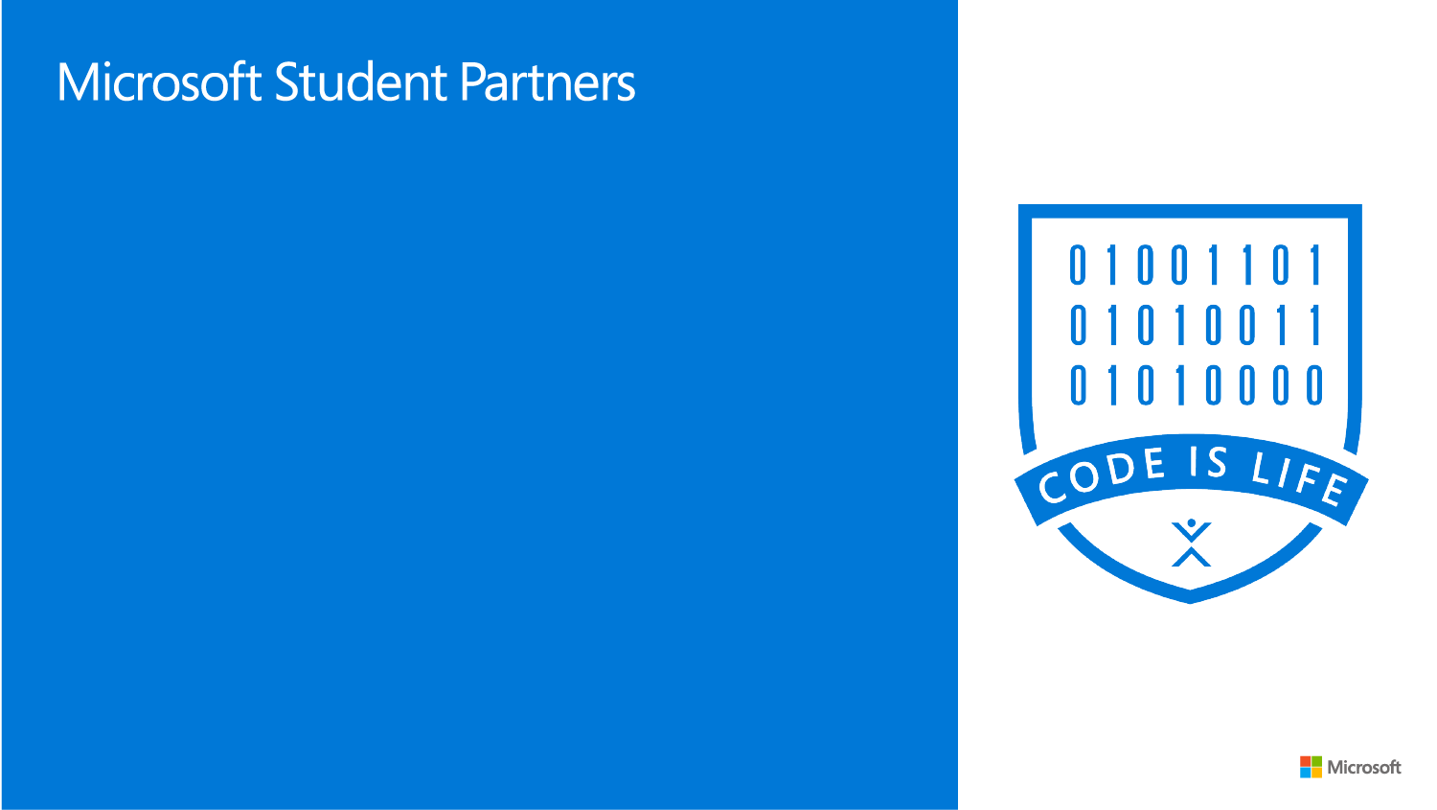
MSP Program
MSP Global Initiative

Slide 3
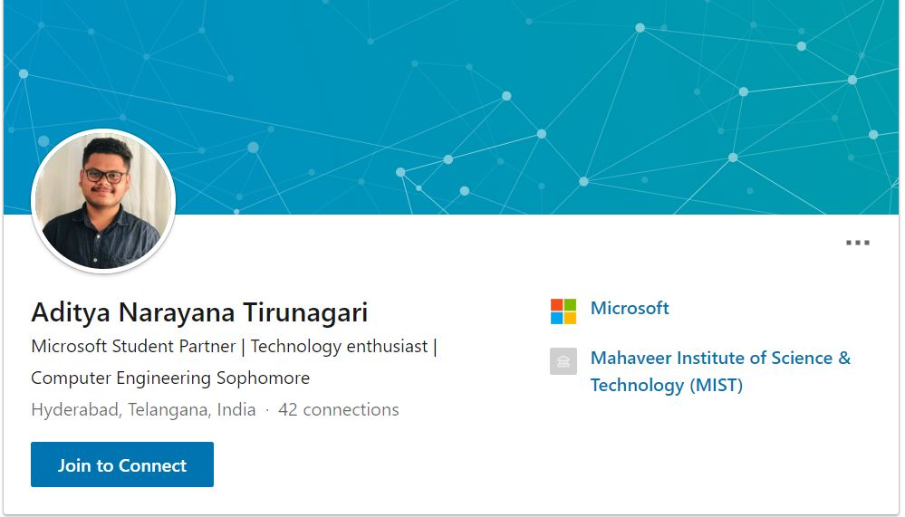
About me
www.linkedin.com/in/adityanarayana

Slide 4
Agenda
What is MSP Program?
How to prepare your MSP Application?
MSP Experience
Benefits of being a MSP
Program Requirements
Imagine Cup

Slide 5
What is MSP Program?

Slide 6
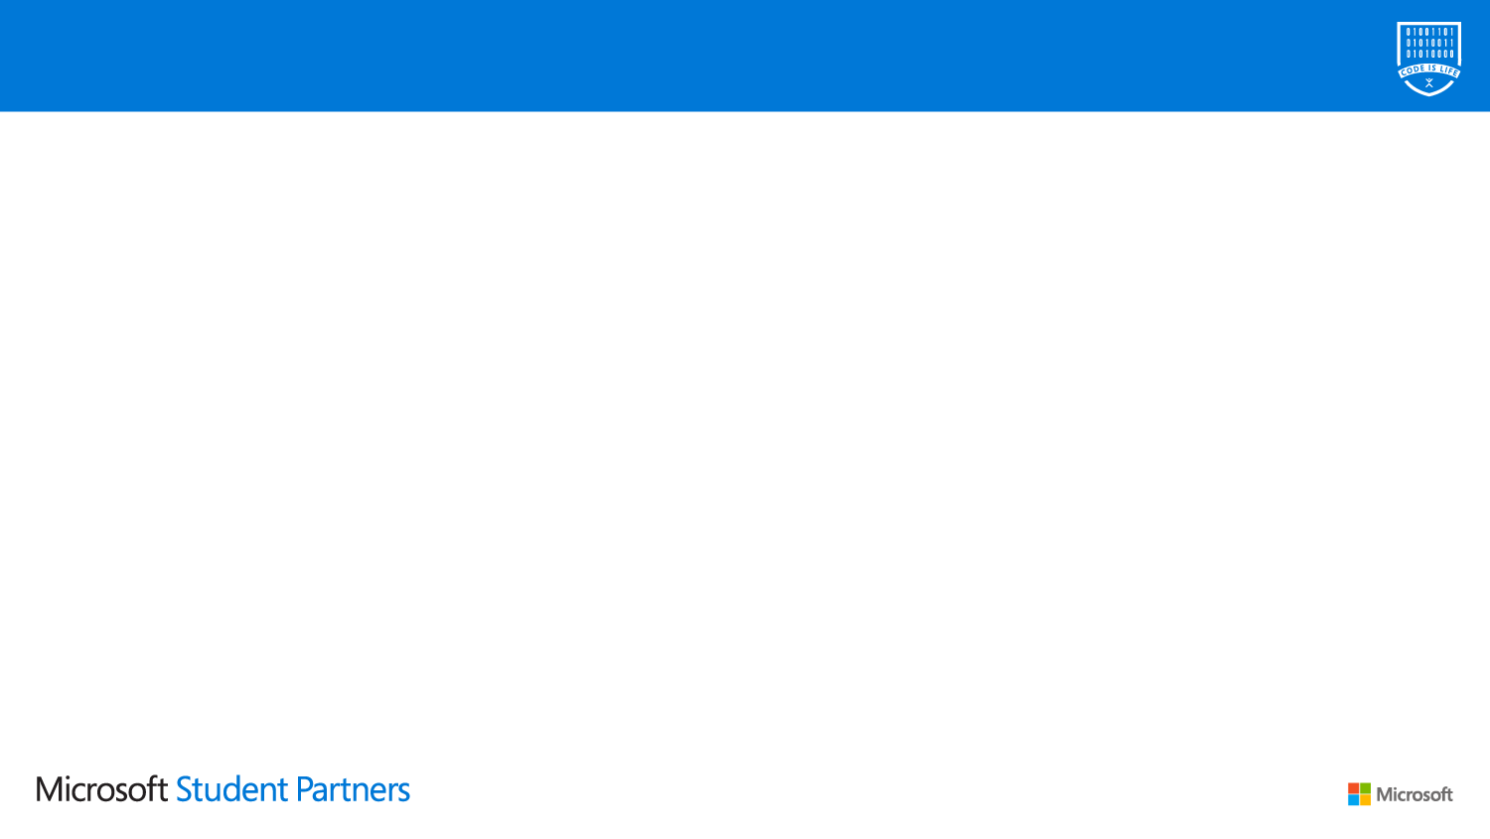
Microsoft Student Partner's Program
Learn
Share
Network
Develop Personality
Golden Opportunity
Global

Slide 7
How to prepare your MSP application

Slide 8
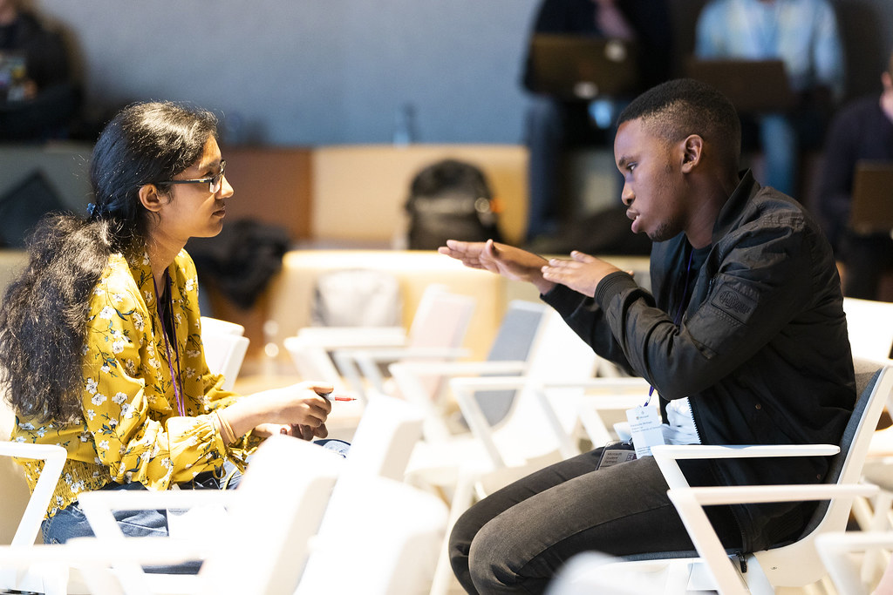
All applying students must
Be at least 16 years old at the time of submission
Be enrolled full-time in an accredited academic institution (e.g. College, University)
Some experience in technology is helpful, but not mandatory
Boost your career in tech, learn and lead while empowering those around you

Slide 9
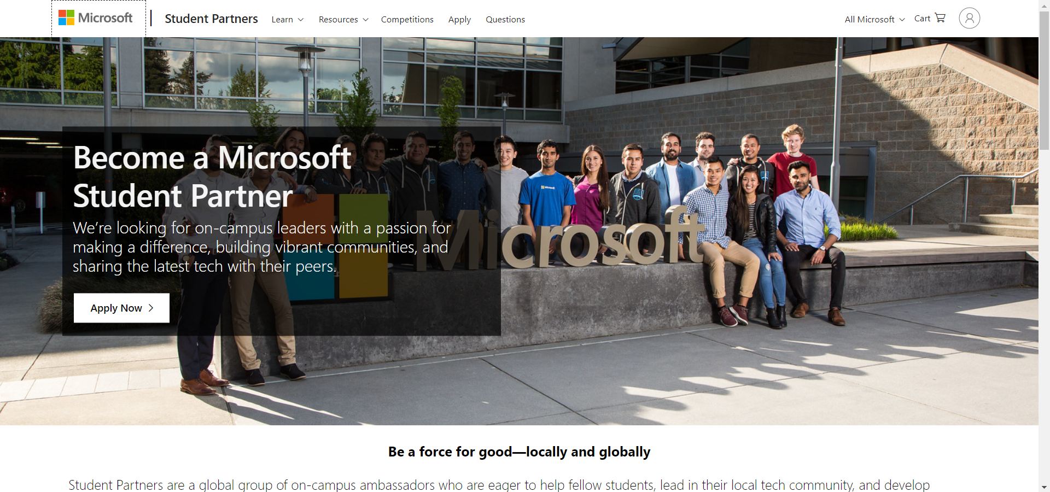
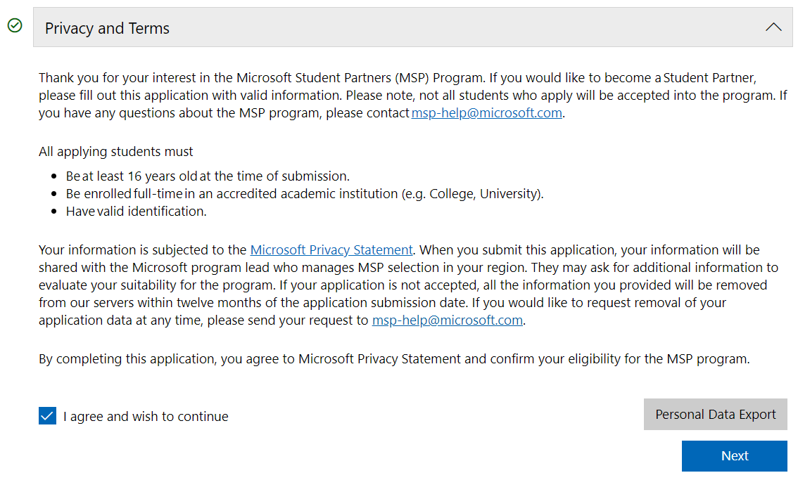
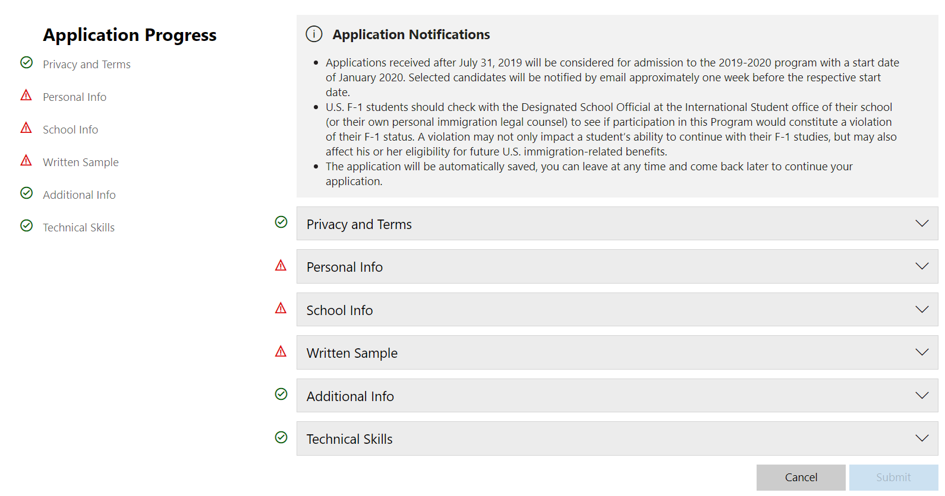
How to apply?
Go to: https://studentpartners.microsoft.com/
Click on Apply Now
Sign in with your MS Account
Read and agree with Privacy and Terms
Fill out the application form

Slide 10
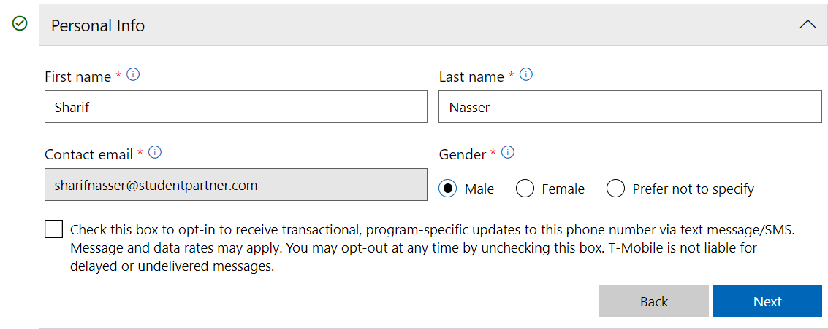
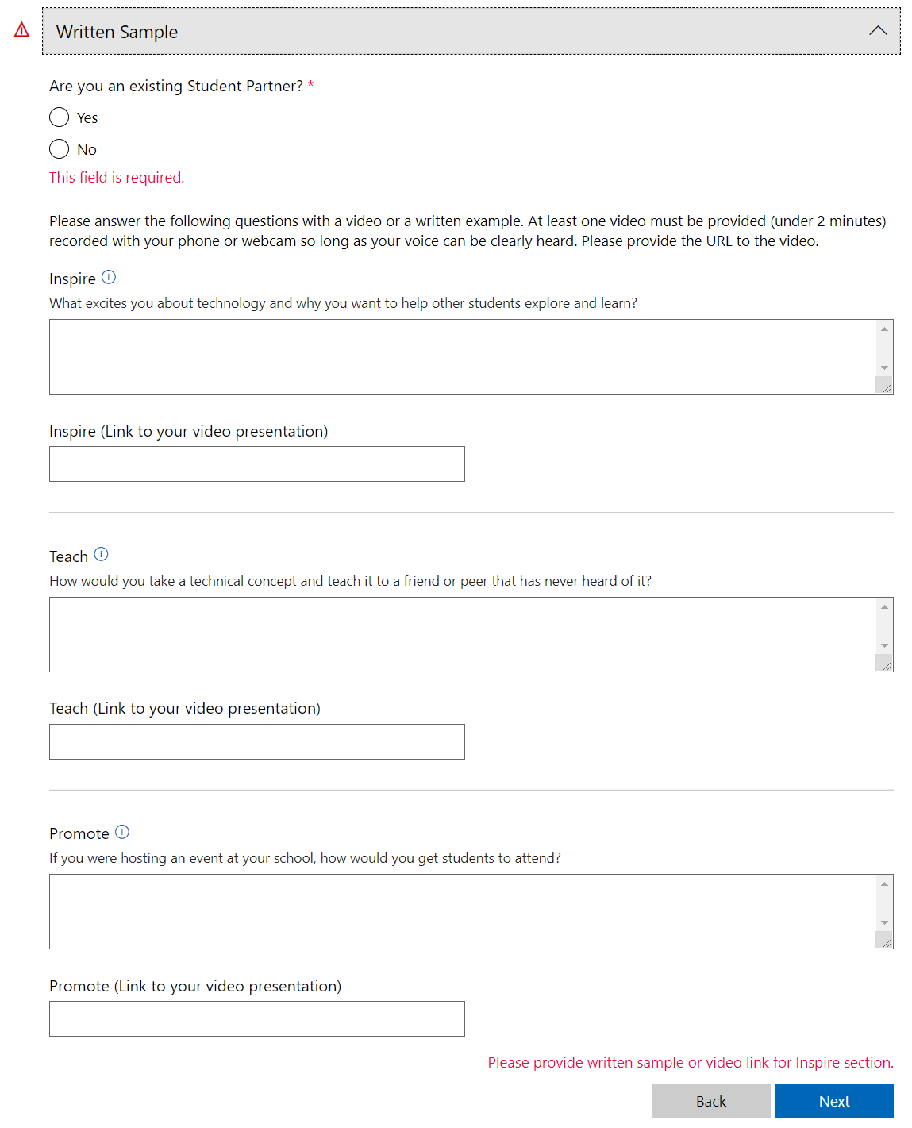
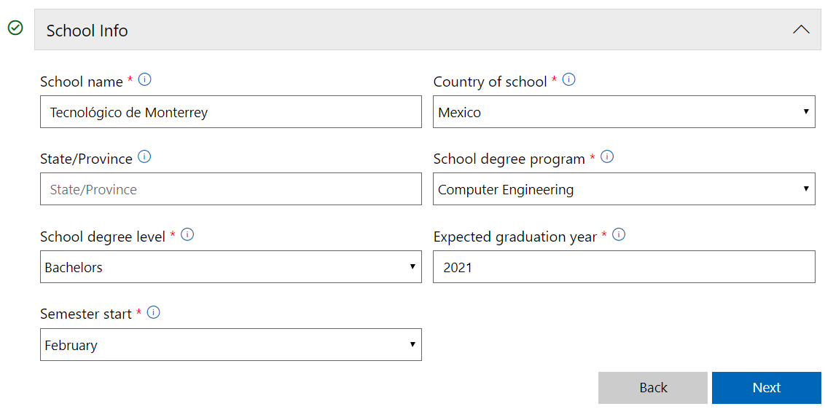
Application Form

Slide 11
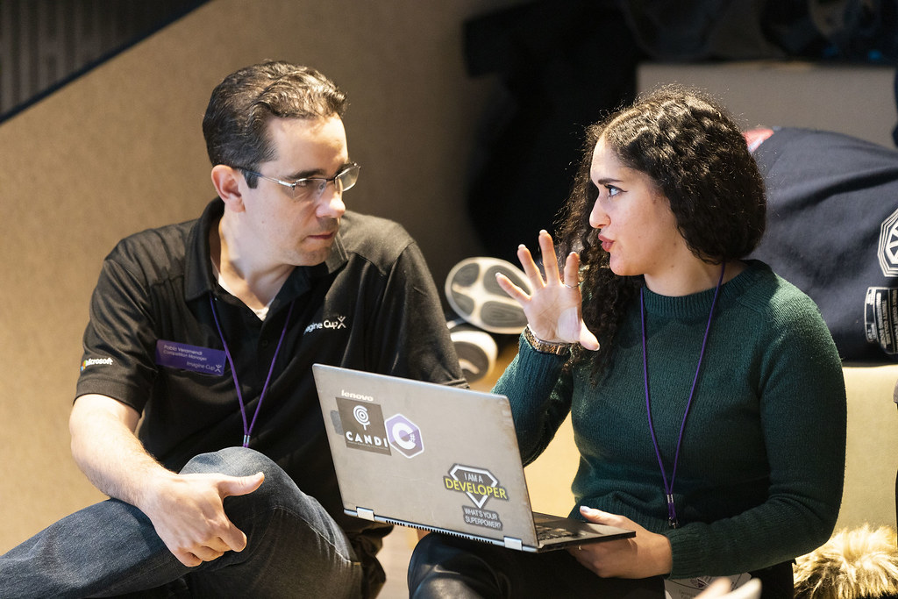
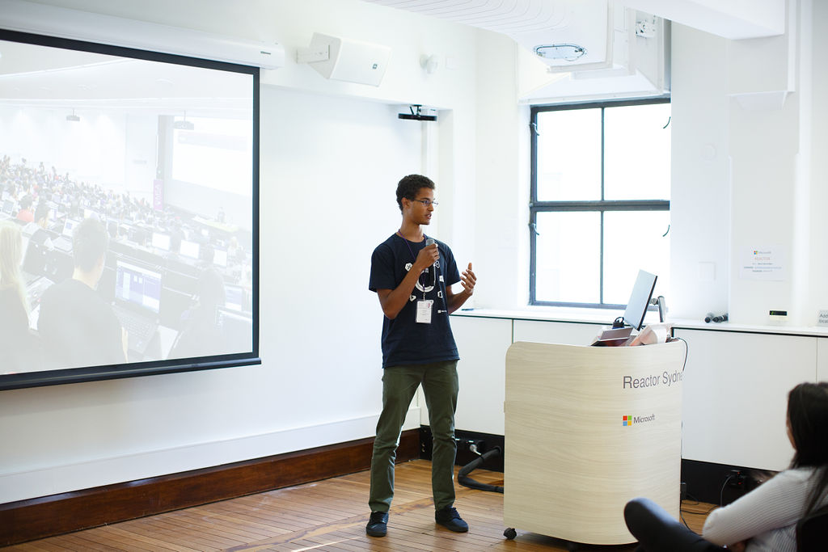
Application Form
INSPIRE
TEACH
PROMOTE
What excites you about technology and why you want to help other students explore and learn?
How would you take a technical concept and teach it to a friend or peer that has never heard of it?
If you were hosting an event at your school, how would you get students to attend?
Answer the questions with a video or a written example. You must deliver at least one video (less than 2 minutes) recorded with a phone or webcam and your voice must be clearly heard.

Slide 12
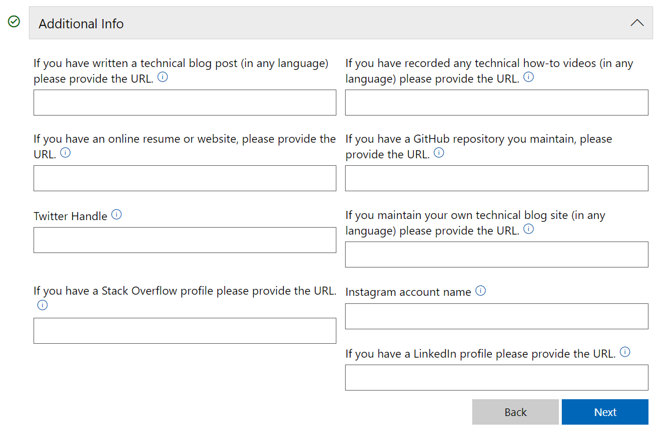
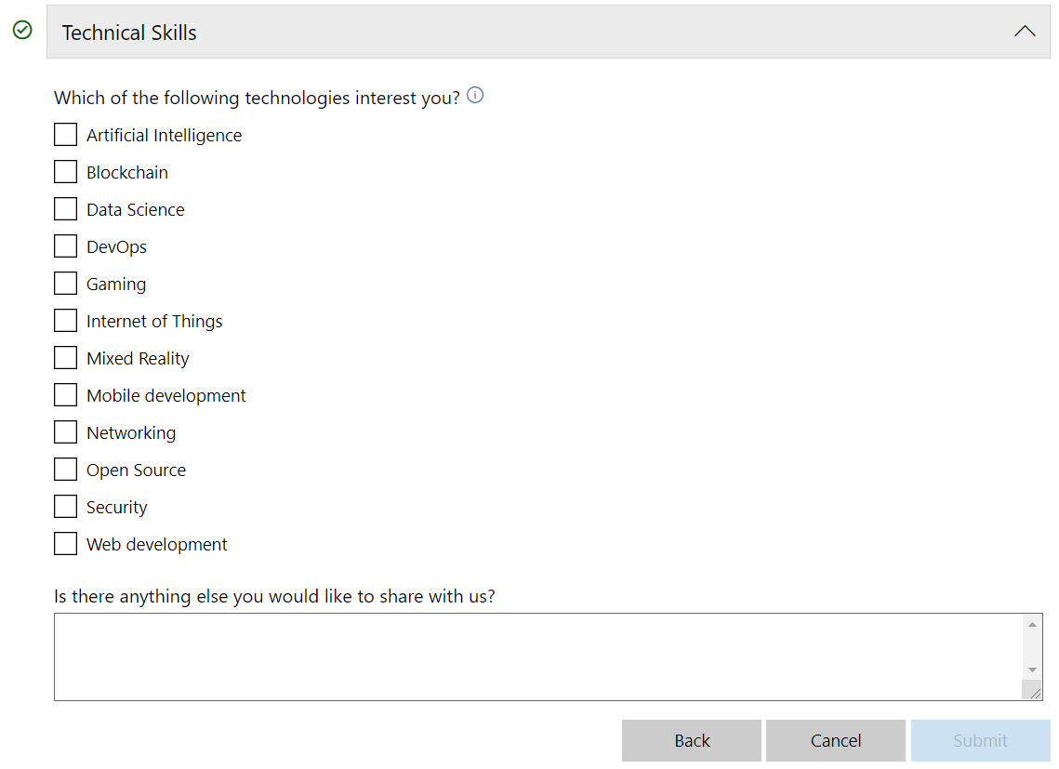
Application Form

Slide 13
Recommendations
Take the time to think your answers well
Be honest, be yourself
Show your passion for:
technology | teaching | sharing | networking | empowering | writing …
It is helpful to support your answers with concise examples
Unleash your creativity
Ask yourself:
Why do you want to be MSP?
What would you do being MSP?
How would you do it?

Slide 14
Next group of Student Partners will be announced in July 2020 (applications are due May 31st, 2020)

Slide 15
MSP Experience

Slide 16
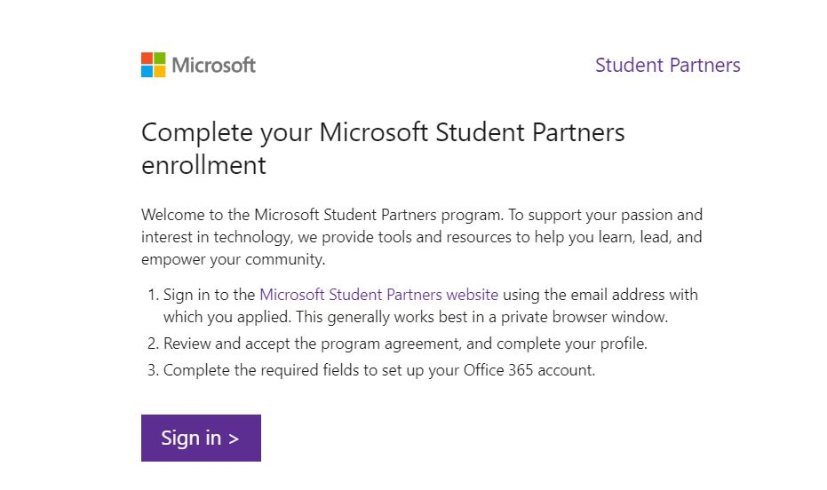
My application to the MSP program
On Thursday, January 9th, 2020

Slide 17
MSP SUMMIT INDIA 2020

Slide 18
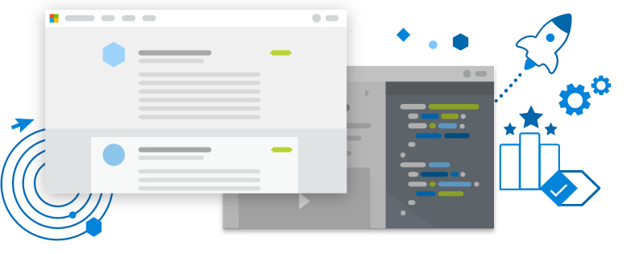

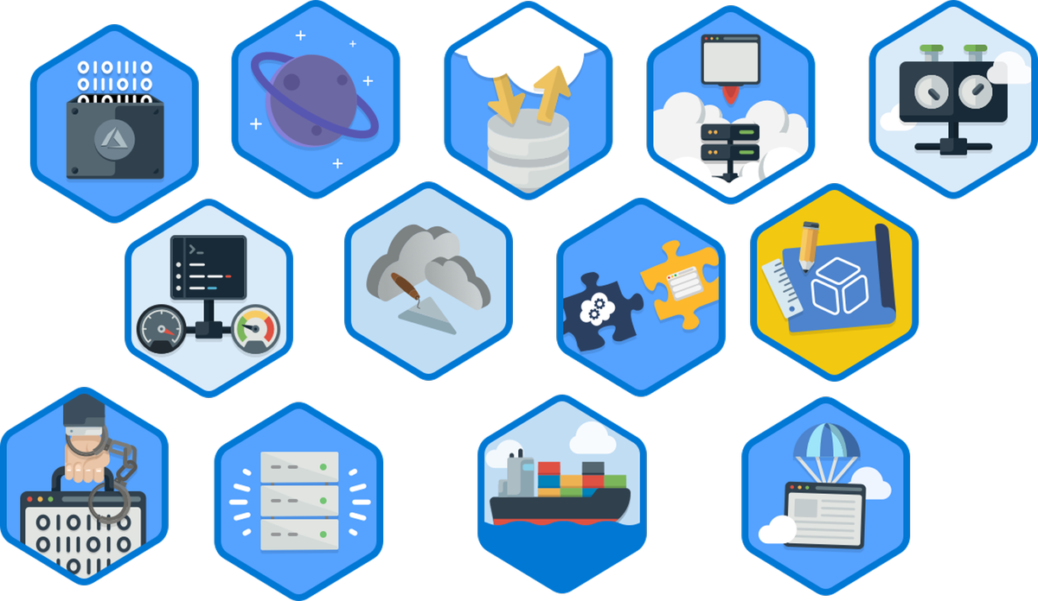
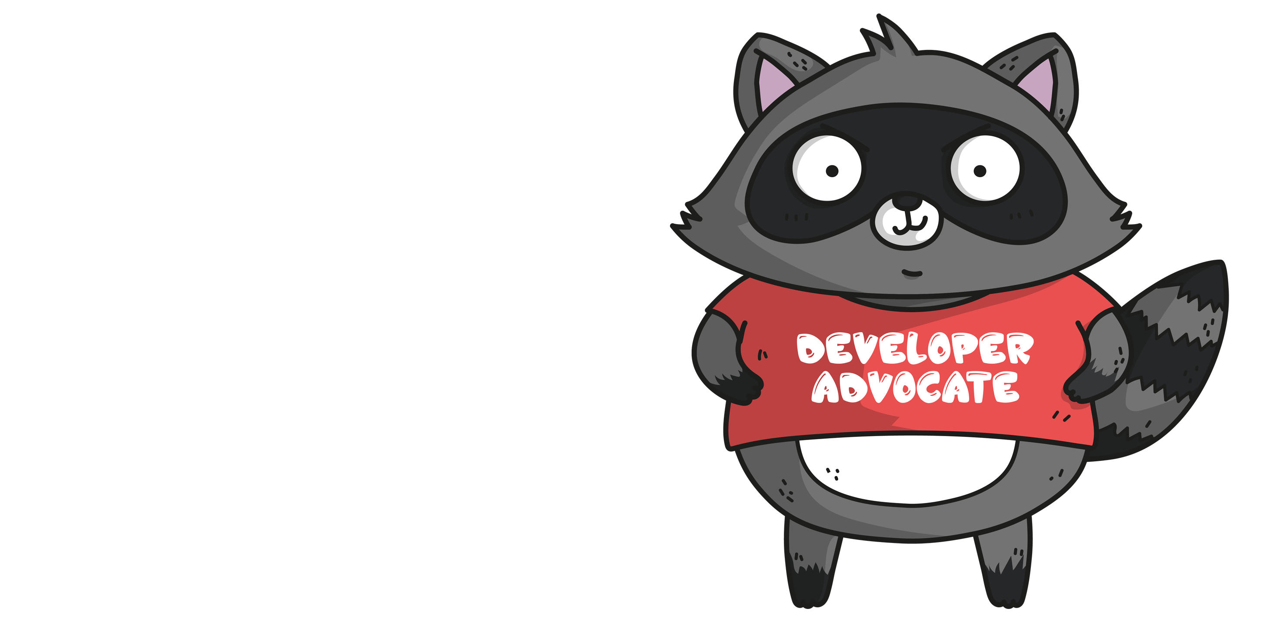
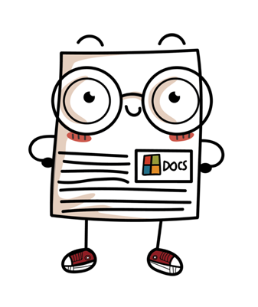

achievements
1. Learn
This Photo by Unknown Author is licensed under CC BY

Slide 19
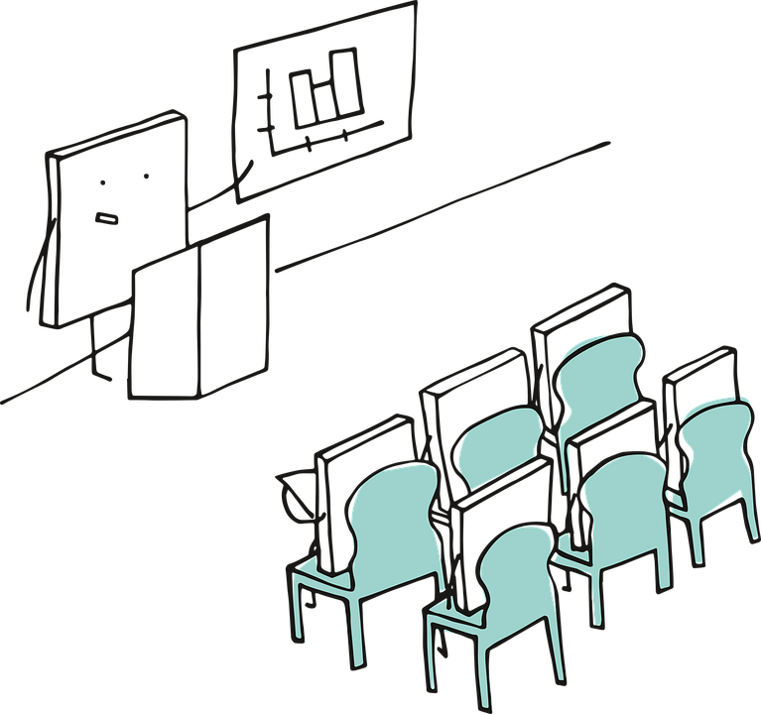
achievements
2. Share knowledge
This Photo by Unknown Author is licensed under CC BY

Slide 20
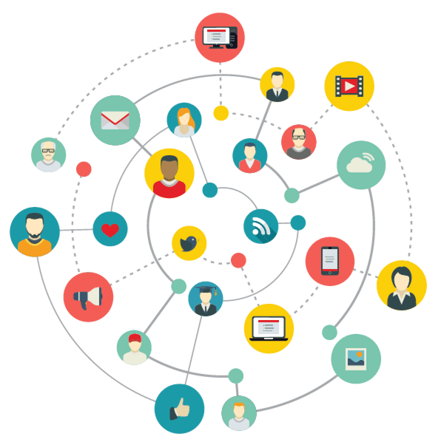
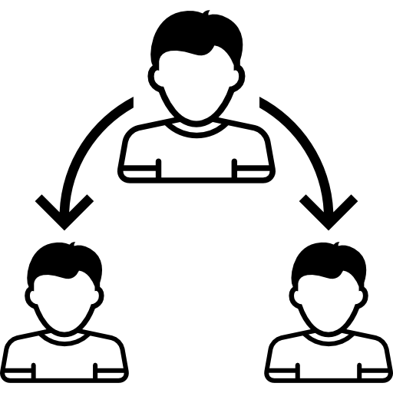
achievements
3. Connect
This Photo by Unknown Author is licensed under CC BY

Slide 21
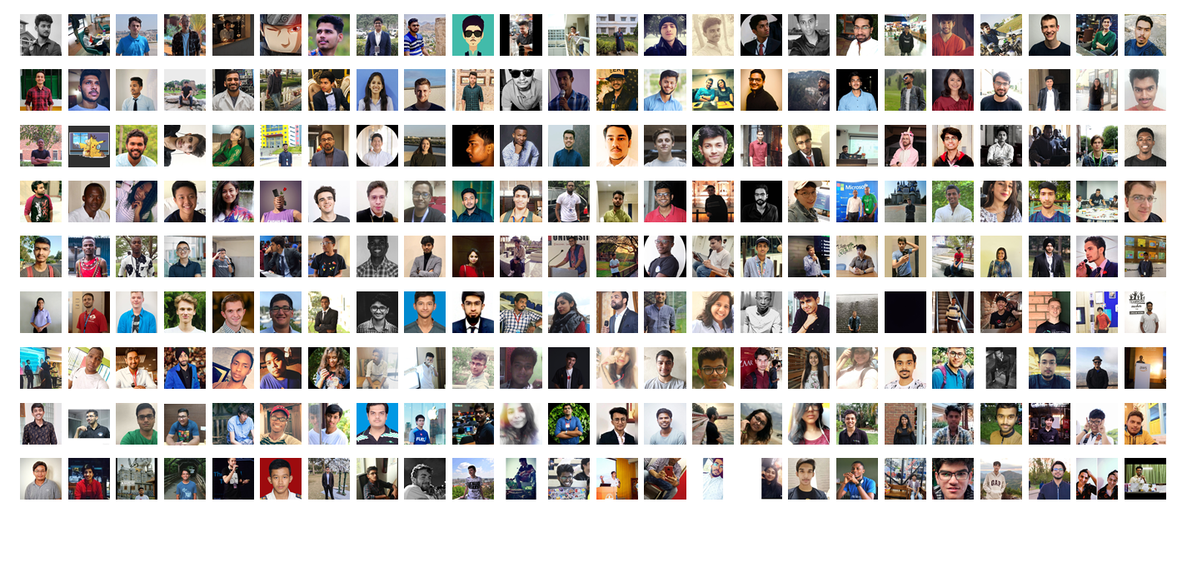
Microsoft Student Partners Community
This Photo by Unknown Author is licensed under CC BY

Slide 22
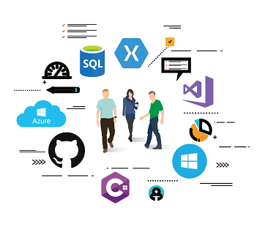


Microsoft Student Partners Community
This Photo by Unknown Author is licensed under CC BY

Slide 23
Benefits of Being Microsoft Student Partner

Slide 24

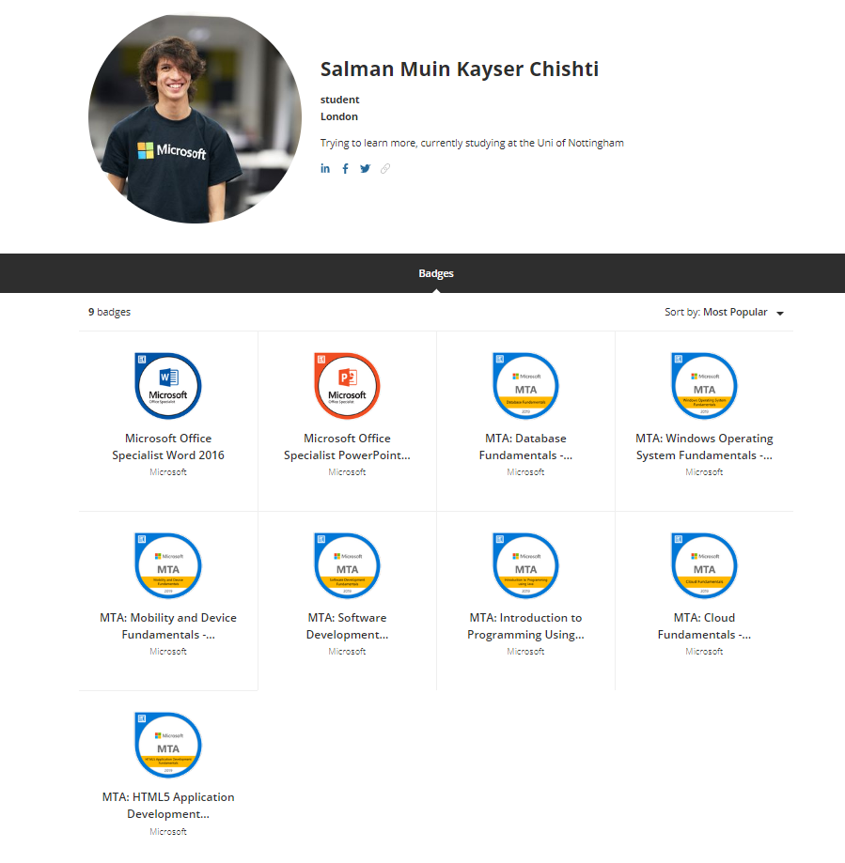
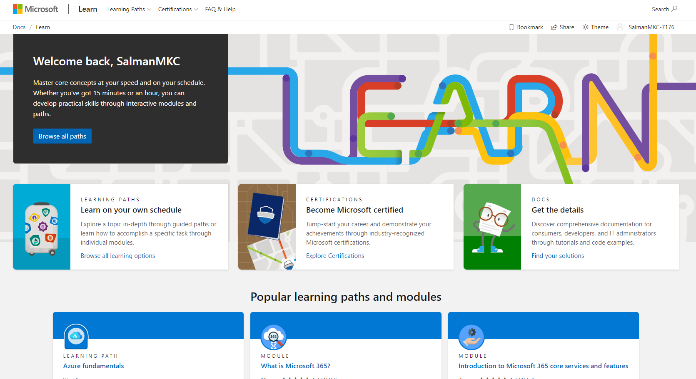
A chance to grow your skills

Slide 25



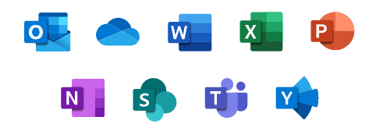



Software and services to aid your efforts

Slide 26
Program Requirement

Slide 27



The MSP Program
Learn
Share
Connect
This Photo by Unknown Author is licensed under CC BY

Slide 28

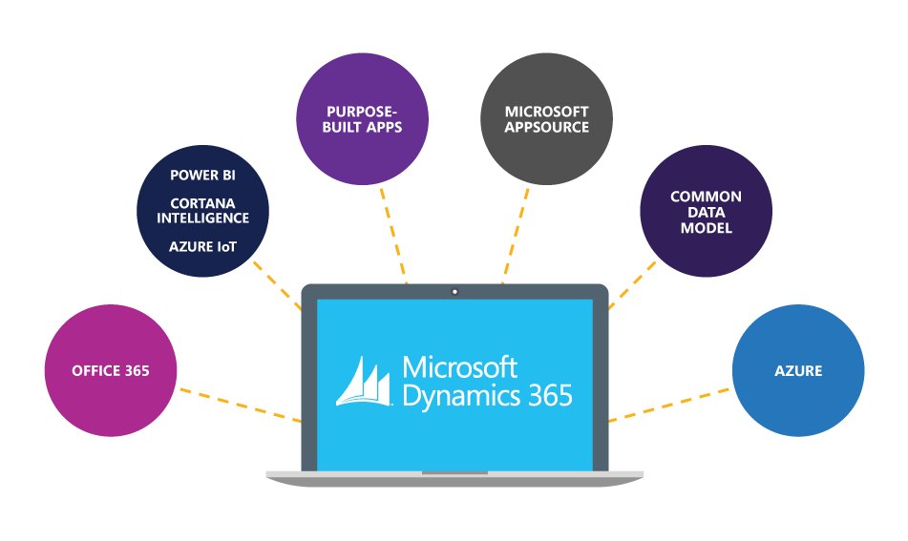
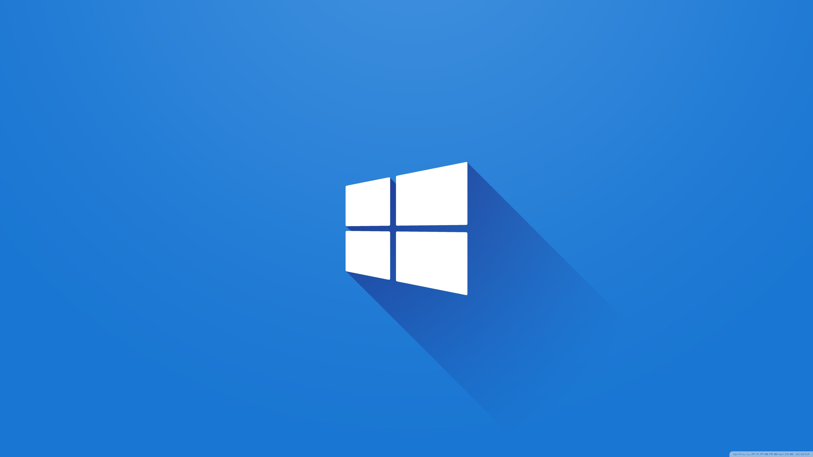
LEARN
Microsoft Resources
yourname@studentpartner.com

Slide 29
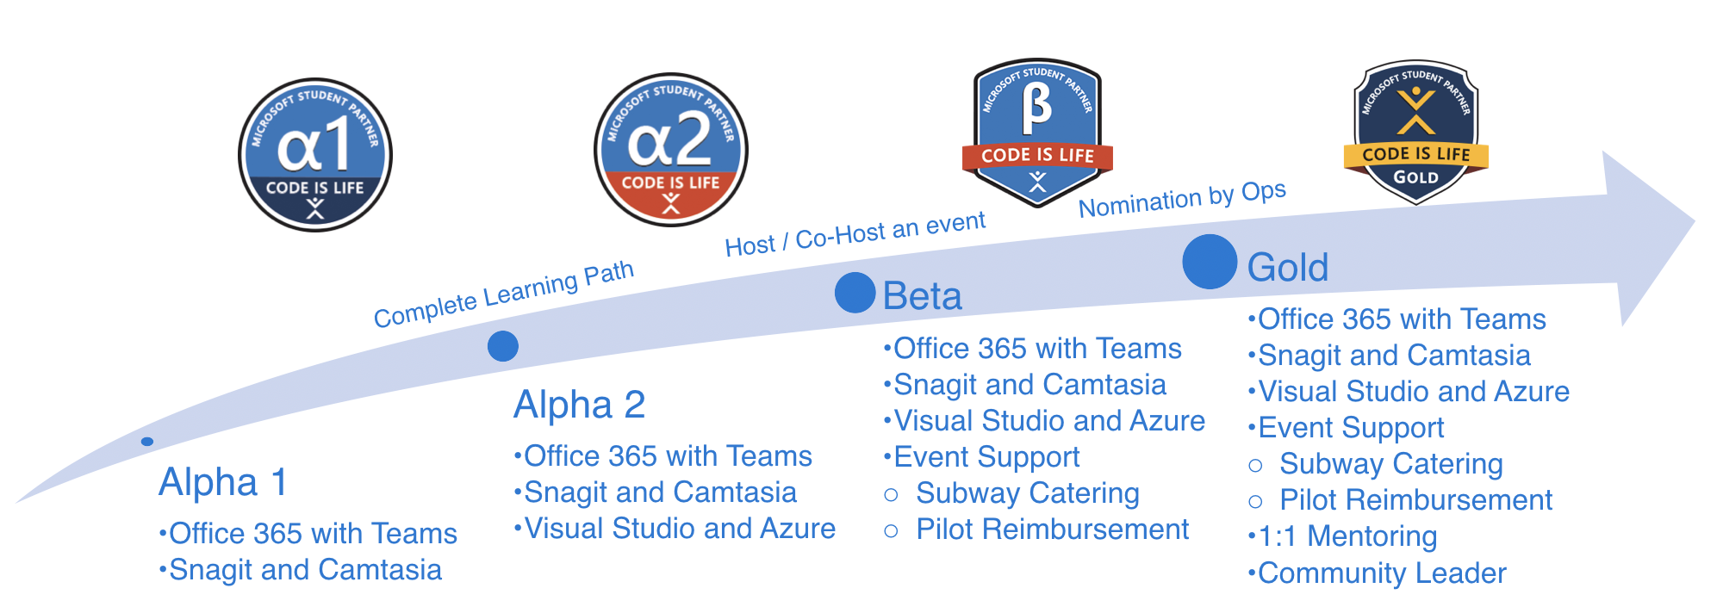
LEARN
MSP milestone scheme

Slide 30





LEAD
Workshop
Hackathon
Sharing

Slide 31







SHARE

Slide 32
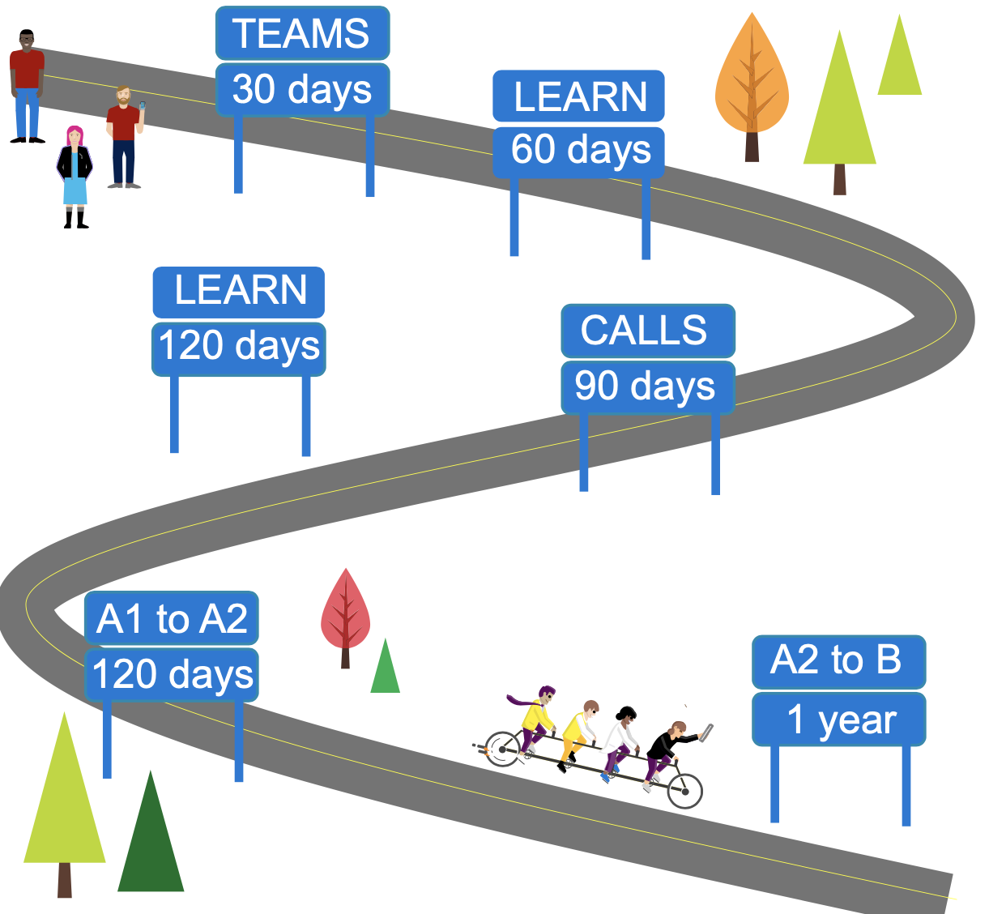
SHARE
Teams
Sign on within first 30 days
Sign on minimum once per 30 days
MS Learn
Start learning path within first 60 days
Complete learning path within 120 days
Calls
Attend CA Happy Hour call once per 90 days
Attend an All Hands call once per 90 days
Milestone Advancement
Advance Alpha 1 to Alpha 2 within first 120 days
Advance Alpha 2 to Beta within first year

Slide 33



Slide 34
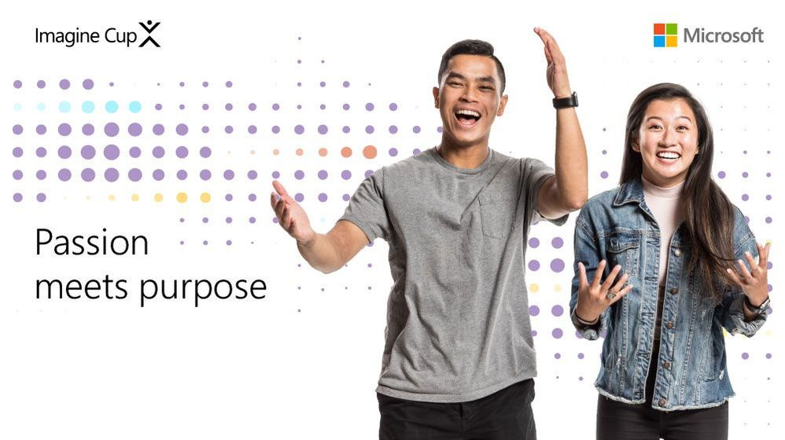

Slide 35
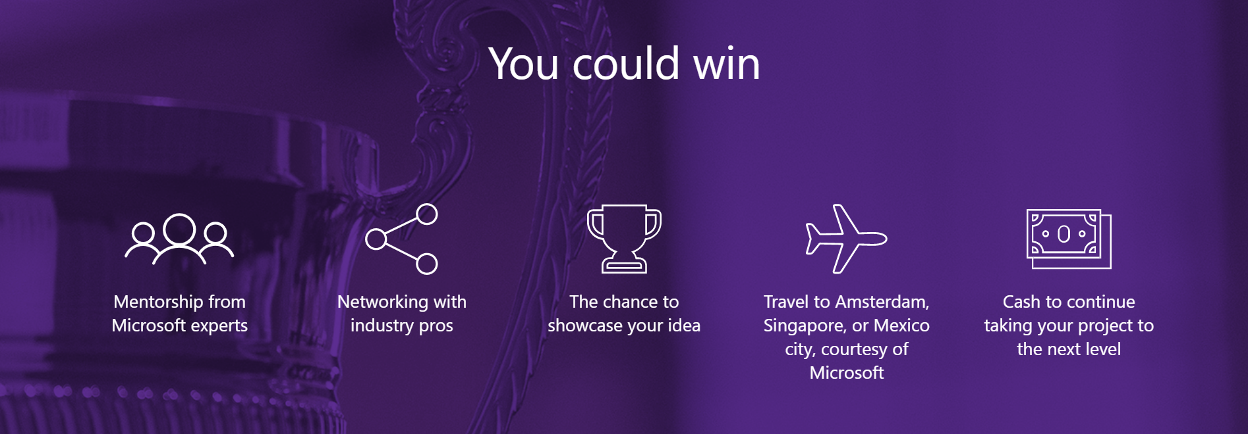
Continued..

Slide 36

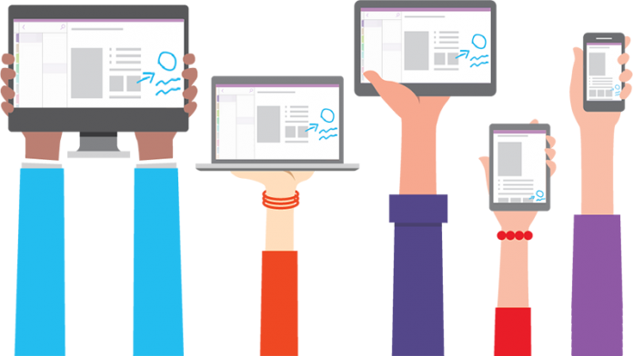
Questions?

Slide 37
Interact with us!
#msftstudentpartner on Twitter
#msftstudentpartner on Instagram
#msftstudentpartner on Linkedin

